Slide 1
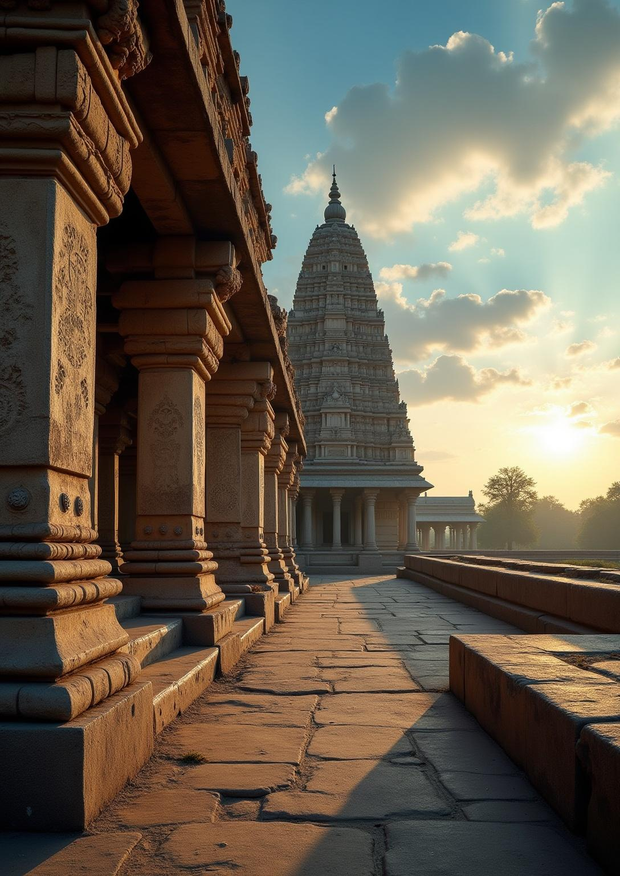
SACRED ENSEMBLES OF THE
HOYSALAS
Presented
By Tarun Hansdah,
Class XII

Slide 2
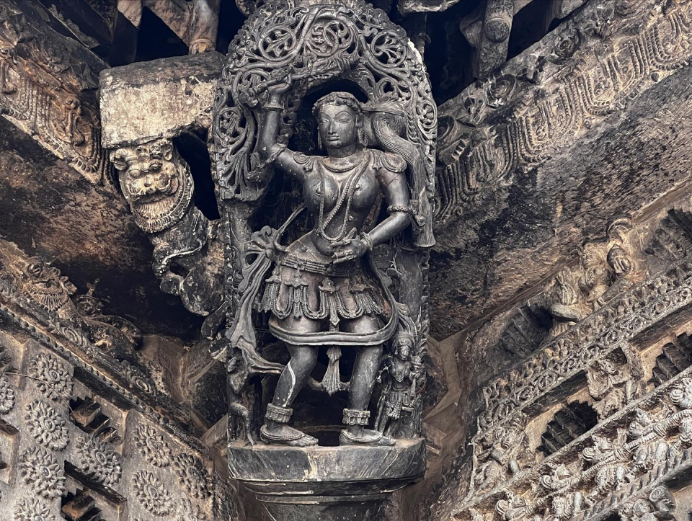
INTRODUCTION
Located in Karnataka, the Sacred Ensembles of the Hoysalas showcase the height of medieval South Indian temple architecture.
They were constructed during the 12th and 13th centuries under the Hoysala dynasty.
The temples reflect a harmonious blend of devotion and artistic excellence.
They symbolize a rich spiritual and cultural heritage that has gained global recognition.

Slide 3
Content
Historical Background
UNESCO World Heritage Recognition
Cultural and Religious importance
Location
Route
Conclusion

Slide 4
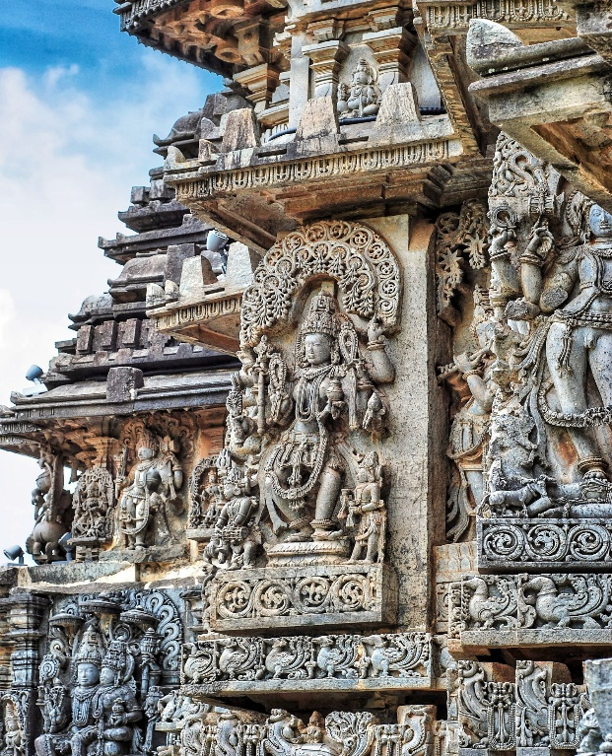
HISTORY OF HOYSALA DYNASTY
The Hoysala dynasty ruled southern India from the 11th to the 14th centuries.
It played a pivotal role in the advancement of temple architecture in the region.
Under rulers such as King Vishnuvardhana, the dynasty experienced significant artistic growth.
This period left a lasting cultural and architectural heritage, clearly reflected in Hoysala temples.

Slide 5
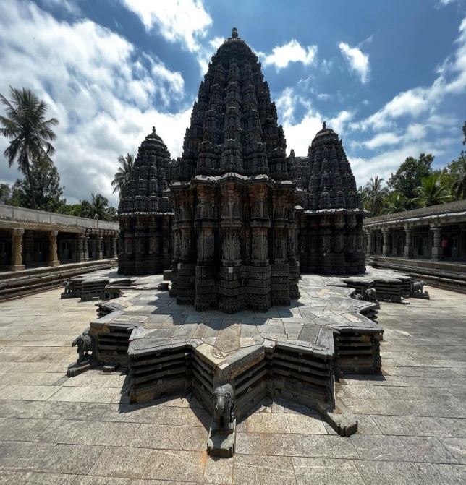
UNESCO RECOGNITION
In 2023, the Sacred Ensembles of the Hoysalas were designated as a UNESCO World Heritage Site.
The designation acknowledges their exceptional architectural and cultural significance.
It highlights their global importance as masterpieces of medieval Indian art.
The recognition also emphasizes their deep devotional and spiritual value.

Slide 6
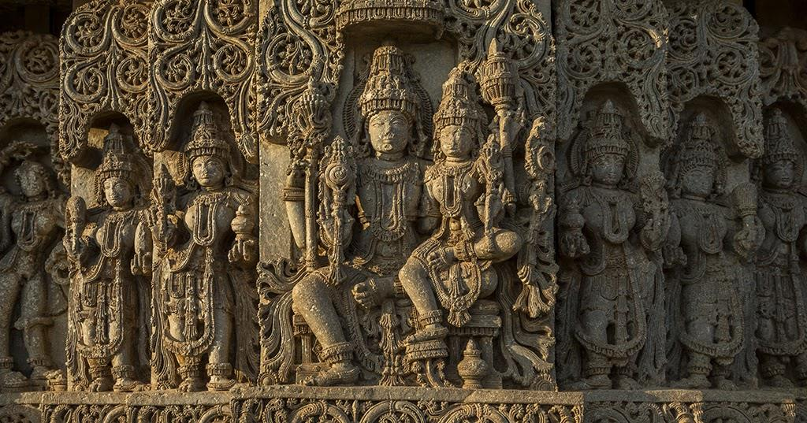
CULTURAL AND RELIGIOUS IMPORTANCE
The Hoysala temples serve as important centers of spiritual worship and cultural expression.
They preserve narratives from Indian epics such as the Ramayana and Mahabharata, reflecting deep religious devotion.
Historically, the temple ensembles functioned as hubs for artistic, social, and community activities.

Slide 7
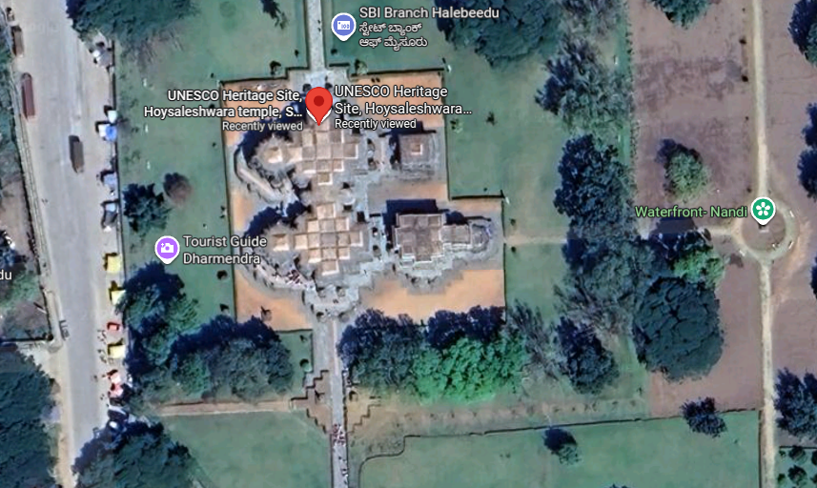
LOCATION
Located primarily in present-day Karnataka, southern India.
The Hoysalas is about 20 kilometers east from Belur.

Slide 8
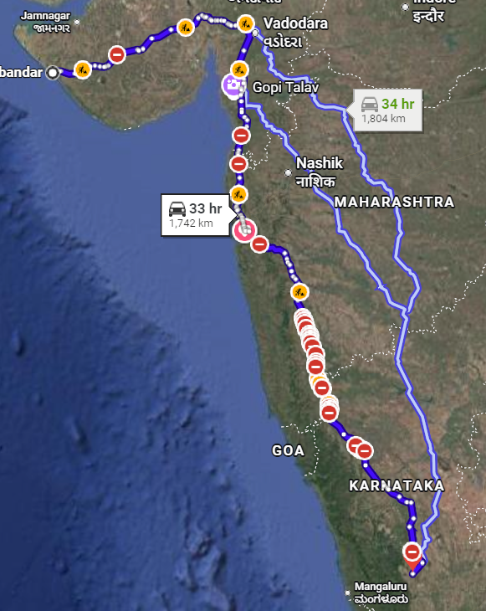
Route from Porbandar
By Road:
1700 – 1800km
Route: Porbandar → Rajkot → Ahmedabad → Vadodara → Nashik → Pune → Kolhapur →Hubballi → Hassan → Belur / Halebidu
25-28 hours
By Air:
Route: Porbandar → Bus/Train →Ahmedabad → Bengaluru → Bus/Taxi → Belur/Halebidu
1-2hour(Flight), 4-5(Road)

Slide 9
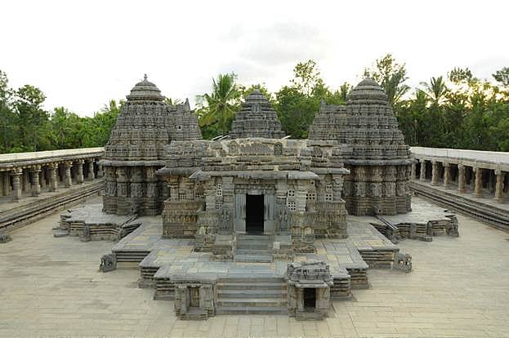
Conclusion
The Sacred Ensembles of the Hoysalas exemplify medieval Indian architectural and religious artistry.
Their intricate design and spiritual value reflect a strong historical legacy.
They attract scholars and visitors worldwide.
The monuments highlight Karnataka’s rich cultural heritage and UNESCO significance.

Slide 10
Thank You!
Presentation by
Tarun Hansdah
Roll no. 16, Class XII
Under the guidance of
Ms. Vandana Ozi ma’ am

